Slide 1
MySQL Triggers
GV: Phạm Thị Quỳnh Trang

Slide 2
Introduction
In MySQL, a trigger is a stored program invoked automatically in response to an event such as insert, update, or delete that occurs in the associated table.
For example, you can define a trigger that is invoked automatically before a new row is inserted into a table.
MySQL supports triggers that are invoked in response to the INSERT, UPDATE or DELETE event.
The SQL standard defines two types of triggers: row-level triggers and statement-level triggers.
A row-level trigger is activated for each row that is inserted, updated, or deleted. For example, if a table has 100 rows inserted, updated, or deleted, the trigger is automatically invoked 100 times for the 100 rows affected.
A statement-level trigger is executed once for each transaction regardless of how many rows are inserted, updated, or deleted.
MySQL supports only row-level triggers. It doesn’t support statement-level triggers.

Slide 3
Disadvantages of triggers
Triggers can only provide extended validations, not all validations. For simple validations, you can use the NOT NULL, UNIQUE, CHECK and FOREIGN KEY constraints.
Triggers can be difficult to troubleshoot because they execute automatically in the database, which may not be visible to the client applications.
Triggers may increase the overhead of the MySQL server.

Slide 4
Advantages of triggers
Triggers provide another way to check the integrity of data.
Triggers handle errors from the database layer.
Triggers give an alternative way to run scheduled tasks. By using triggers, you don’t have to wait for the scheduled events to run because the triggers are invoked automatically before or after a change is made to the data in a table.
Triggers can be useful for auditing the data changes in tables.

Slide 5
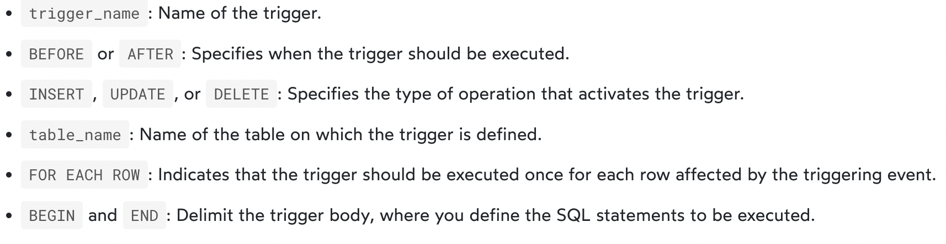
MySQL Create Trigger
CREATE TRIGGER trigger_name
{BEFORE | AFTER} {INSERT | UPDATE | DELETE}
ON table_name
FOR EACH ROW
BEGIN
-- Trigger body (SQL statements)
END;

Slide 6
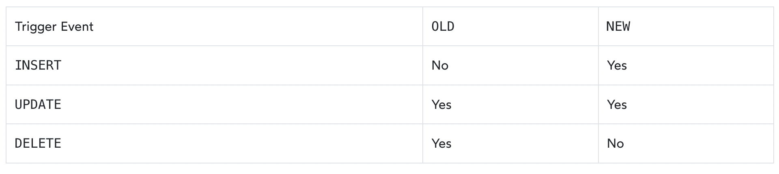
MySQL Create Trigger:
The availability of the OLD and NEW modifiers

Slide 7
MySQL trigger example
First, create a new table called items:
CREATE TABLE items (
id INT PRIMARY KEY,
name VARCHAR(255) NOT NULL,
price DECIMAL(10, 2) NOT NULL
);
Second, insert a row into the items table:
INSERT INTO items(id, name, price)
VALUES (1, 'Item', 50.00);

Slide 8
MySQL trigger example
Third, create the item_changes table to store the changes made to the data in the items table:
CREATE TABLE item_changes (
change_id INT PRIMARY KEY AUTO_INCREMENT,
item_id INT,
change_type VARCHAR(10),
change_timestamp TIMESTAMP DEFAULT CURRENT_TIMESTAMP,
FOREIGN KEY (item_id) REFERENCES items(id)
);

Slide 9
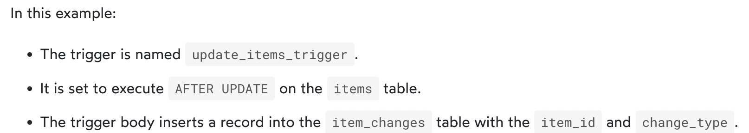
MySQL trigger example
Fourth, create a trigger called update_items_trigger associated with the items table:F
DELIMITER //
CREATE TRIGGER update_items_trigger
AFTER UPDATE
ON items
FOR EACH ROW
BEGIN
INSERT INTO item_changes (item_id, change_type)
VALUES (NEW.id, 'UPDATE');
END;
//
DELIMITER ;

Slide 10
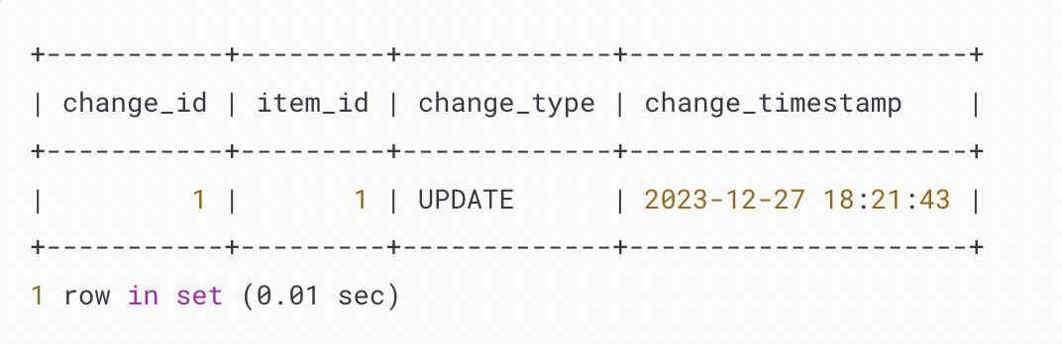
MySQL trigger example
Fifth, update a row in the items table:
UPDATE items
SET price = 60.00
WHERE id = 1;
Finally, retrieve data from the item_changes table to see the logged changes:
SELECT * FROM item_changes;
Output:

Slide 11
MySQL DROP TRIGGER
Syntax:
DROP TRIGGER [IF EXISTS] [schema_name.]trigger_name;
In this syntax:
First, specify the name of the trigger that you want to drop after the DROP TRIGGER keywords.
Second, specify the name of the schema to which the trigger belongs. If you skip the schema name, the statement will drop the trigger in the current database.
Third, use IF EXISTS option to conditionally drop the trigger if the trigger exists. The IF EXISTS clause is optional.
If you drop a trigger that does not exist without using the IF EXISTS clause, MySQL issues an error. However, if you use the IF EXISTS clause, MySQL issues a NOTE instead.

Slide 12
MySQL DROP TRIGGER example
Drop the update_items_trigger trigger:
DROP TRIGGER update_items_trigger;
Show the triggers again to verify the removal:
SHOW TRIGGERS;

Slide 13
MySQL BEFORE INSERT triggers
MySQL BEFORE INSERT triggers are automatically fired before an insert event occurs on the table.
The following illustrates the basic syntax of creating a MySQL BEFORE INSERT trigger:
CREATE TRIGGER trigger_name
BEFORE INSERT
ON table_name FOR EACH ROW
trigger_body;
In this syntax:
First, specify the name of the trigger that you want to create in the CREATE TRIGGER clause.
Second, use BEFORE INSERT clause to specify the time to invoke the trigger.
Third, specify the name of the table that the trigger is associated with after the ON keyword.
Finally, specify the trigger body which contains one or more SQL statements that execute when the trigger is invoked.

Slide 14
MySQL BEFORE INSERT triggers
If you have multiple statements in the trigger_body, you have to use the BEGIN END block and change the default delimiter:
DELIMITER $$
CREATE TRIGGER trigger_name
BEFORE INSERT
ON table_name FOR EACH ROW
BEGIN
-- statements
END$$
DELIMITER ;
Note that in a BEFORE INSERT trigger, you can access and change the NEW values. However, you cannot access the OLD values because OLD values obviously do not exist.

Slide 15
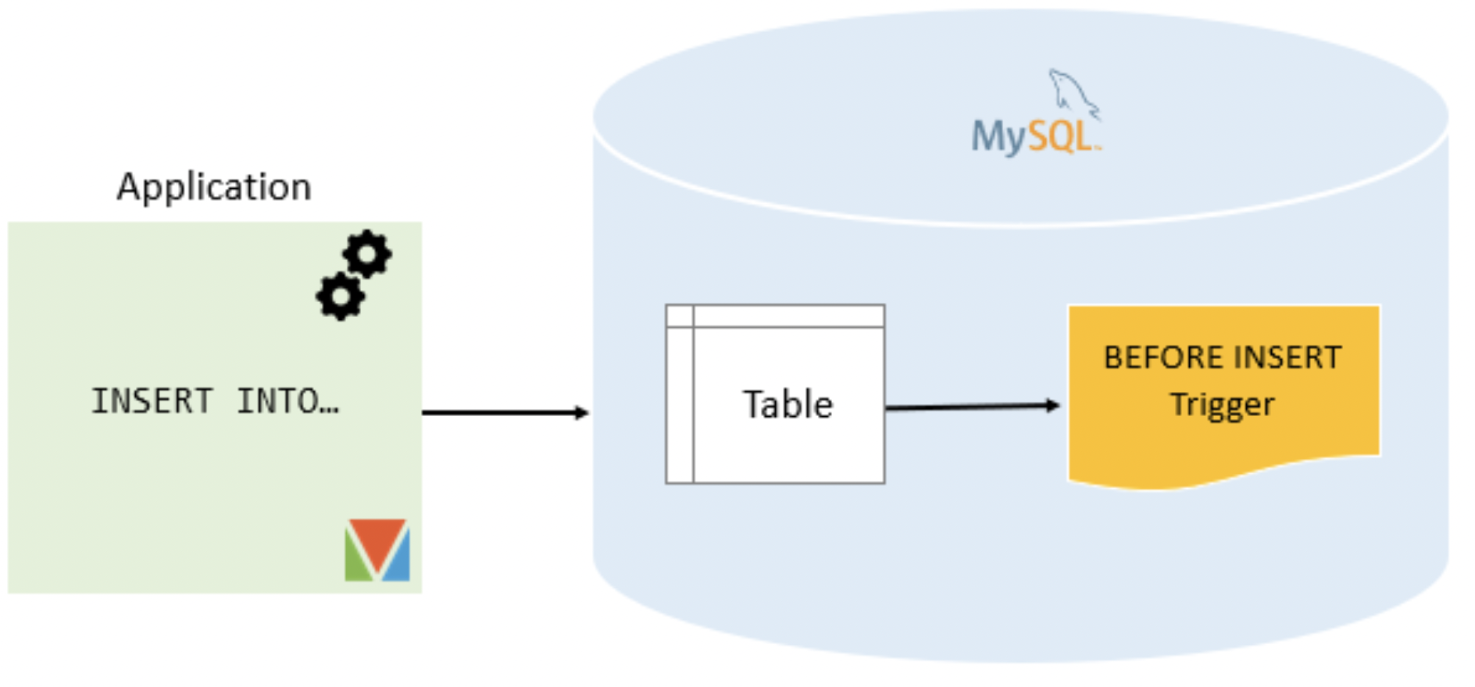
MySQL BEFORE INSERT triggers

Slide 16
MySQL BEFORE INSERT trigger example
We will create a BEFORE INSERT trigger to maintain a summary table from another table.
Setting up a sample table
First, create a new table called WorkCenters:
DROP TABLE IF EXISTS WorkCenters;
CREATE TABLE WorkCenters (
id INT AUTO_INCREMENT PRIMARY KEY,
name VARCHAR(100) NOT NULL,
capacity INT NOT NULL
);

Slide 17
MySQL BEFORE INSERT trigger example
Second, create another table called WorkCenterStats that stores the summary of the capacity of the work centers:
DROP TABLE IF EXISTS WorkCenterStats;
CREATE TABLE WorkCenterStats(
totalCapacity INT NOT NULL
);

Slide 18
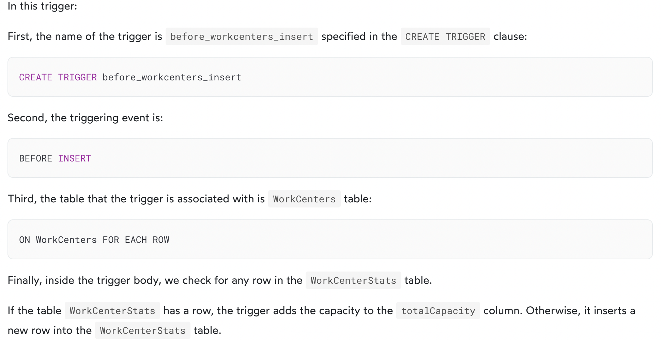
MySQL BEFORE INSERT trigger example
The following trigger updates the total capacity of the WorkCenterStats table before a new work center is inserted into the WorkCenter table:
DELIMITER $$
CREATE TRIGGER before_workcenters_insert BEFORE INSERT ON WorkCenters FOR EACH ROW
BEGIN
DECLARE rowcount INT
SELECT COUNT(*) INTO rowcount FROM WorkCenterStats
IF rowcount > 0 THEN
UPDATE WorkCenterStats SET totalCapacity = totalCapacity + new.capacity;
ELSE
INSERT INTO WorkCenterStats(totalCapacity) VALUES(new.capacity);
END IF;
END $$
DELIMITER ;

Slide 19
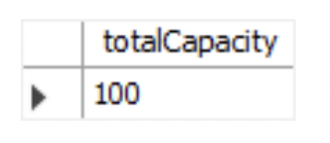
Testing the MySQL BEFORE INSERT trigger
First, insert a new row into the WorkCenter table:
INSERT INTO WorkCenters(name, capacity)
VALUES('Mold Machine',100);
Second, query data from the WorkCenterStats table:
SELECT * FROM WorkCenterStats;
Output

Slide 20

Testing the MySQL BEFORE INSERT trigger
Third, insert a new work center:
INSERT INTO WorkCenters(name, capacity)
VALUES('Packing',200);
Finally, query data from the WorkCenterStats:
SELECT * FROM WorkCenterStats;
Output:
The trigger has updated the total capacity from 100 to 200 as expected.
Note that to properly maintain the summary table WorkCenterStats, you should also create triggers to handle update and delete events on the WorkCenters table.

Slide 21
MySQL AFTER INSERT Trigger
MySQL AFTER INSERT triggers are automatically invoked after an insert event occurs on the table.
The following shows the basic syntax of creating a MySQL AFTER INSERT trigger:
CREATE TRIGGER trigger_name
AFTER INSERT
ON table_name FOR EACH ROW
trigger_body

Slide 22
MySQL BEFORE UPDATE Trigger
MySQL BEFORE UPDATE triggers are invoked automatically before an update event occurs on the table associated with the triggers.
Here is the syntax for creating a MySQL BEFORE UPDATE trigger:
CREATE TRIGGER trigger_name
BEFORE UPDATE
ON table_name FOR EACH ROW
trigger_body

Slide 23
MySQL AFTER UPDATE Trigger
MySQL AFTER UPDATE triggers are invoked automatically after an update event occurs on the table associated with the triggers.
The following shows the syntax of creating a MySQL AFTER UPDATE trigger:
CREATE TRIGGER trigger_name
AFTER UPDATE
ON table_name FOR EACH ROW
trigger_body

Slide 24
MySQL BEFORE DELETE Trigger
MySQL BEFORE DELETE triggers are fired automatically before a delete event occurs in a table.
Here is the basic syntax of creating a MySQL BEFORE DELETE trigger:
CREATE TRIGGER trigger_name
BEFORE DELETE
ON table_name FOR EACH ROW
trigger_body

Slide 25
MySQL AFTER DELETE Trigger
MySQL AFTER DELETE triggers are automatically invoked after a delete event occurs on the table.
Here is the basic syntax of creating a MySQL AFTER DELETE trigger:
CREATE TRIGGER trigger_name
AFTER DELETE
ON table_name FOR EACH ROW
trigger_body;

Slide 26
Create Multiple Triggers
Before MySQL version 5.7.2, you could only create one trigger for an event in a table e.g., you could only create one trigger for the BEFORE UPDATE or AFTER UPDATE event.
MySQL 5.7.2+ lifted this limitation and allowed you to create multiple triggers for a given table that have the same event and action time. These triggers will activate sequentially when an event occurs.

Slide 27
Create Multiple Triggers
DELIMITER $$
CREATE TRIGGER trigger_name
{BEFORE|AFTER}{INSERT|UPDATE|DELETE}
ON table_name FOR EACH ROW
{FOLLOWS|PRECEDES} existing_trigger_name
BEGIN
-- statements
END$$
DELIMITER ;

Slide 28
How To Call a Stored Procedure From a Trigger in MySQL?

